Slide 1

Project Capstone
Property Listings
Presented by Ziniya Shivani Humayun
Ramesh

Slide 2
Objective
Analyze property pricing trends across locations (state, city, zipcode) and property features (bedrooms, bathrooms, area).
Compare actual listing prices to market estimates and rent estimates.
Identify factors influencing price per square foot and overall property valuation.
Enable ad hoc exploration of “What-If” scenarios (e.g., adjusting price per square foot to estimate potential market value or rental yield).

Slide 3
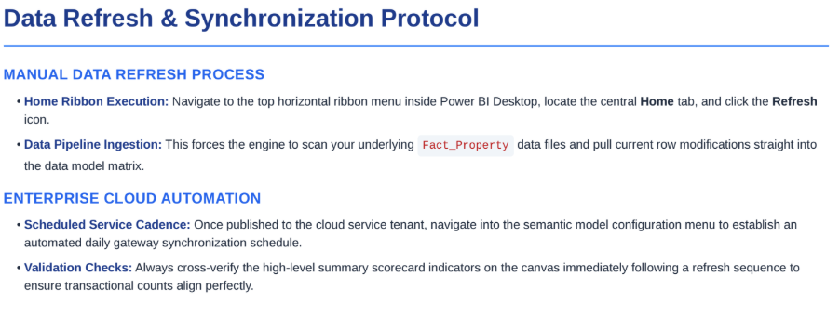
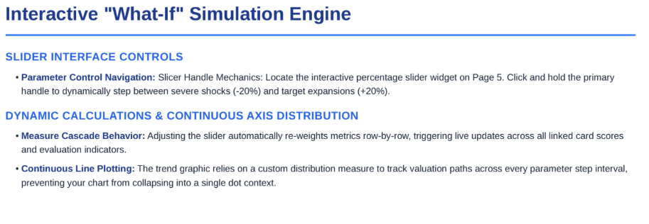
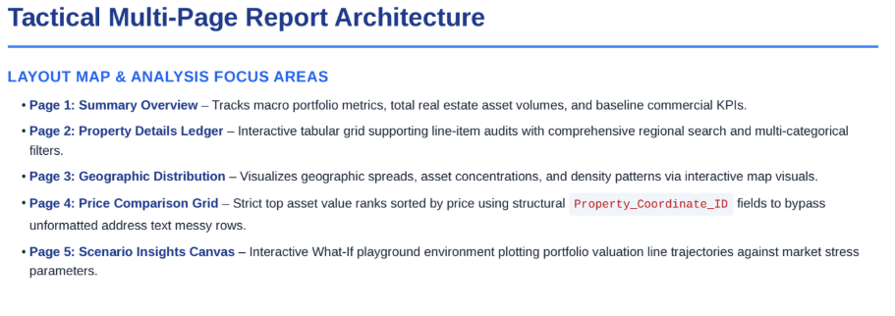
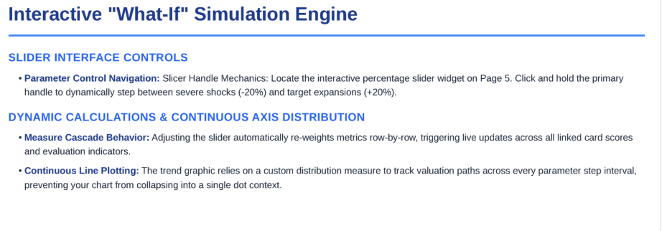
End-User Operations Guide & Quick-Reference Manual

Slide 4
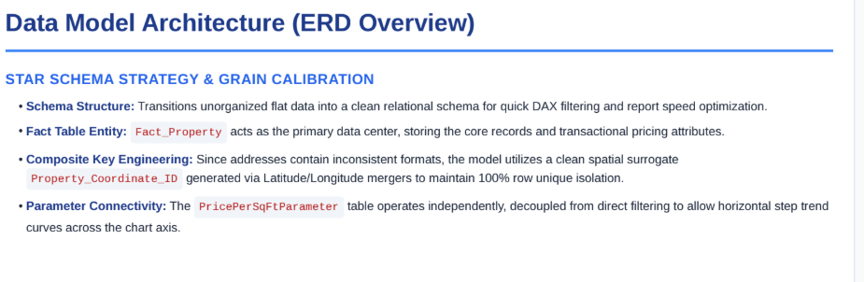
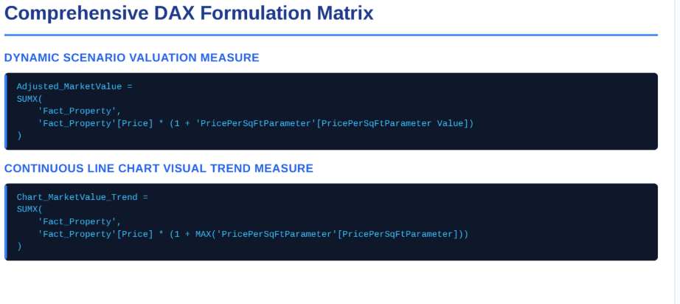
Technical Document

Slide 5
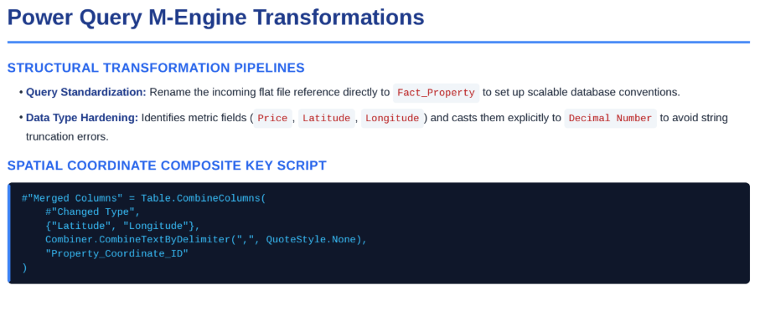

Slide 6
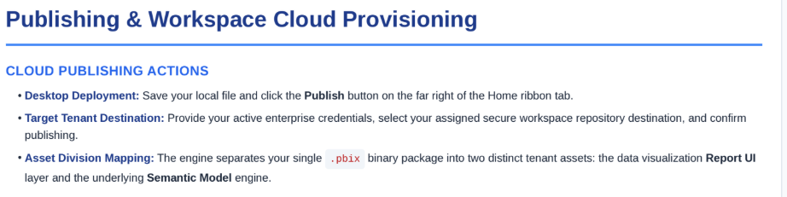
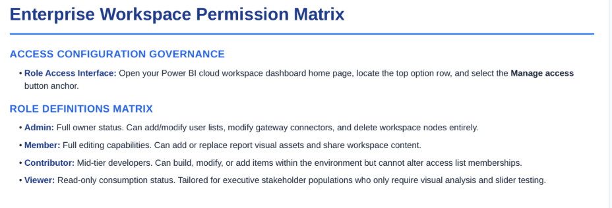
Publish to Power BI Service

Slide 7
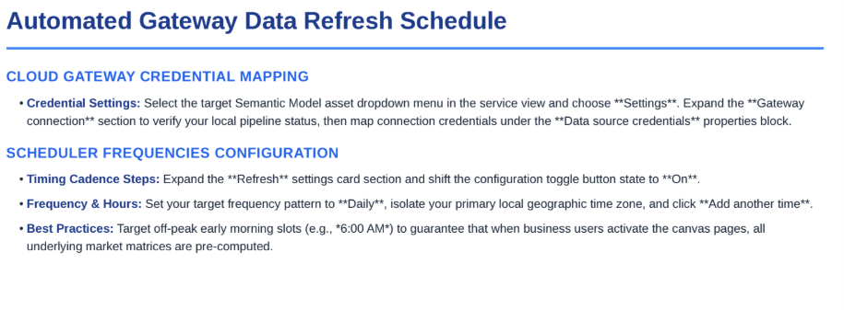

Slide 8
Thank you

